Slide 1
Some of the solutions available on Azure

Slide 2
Agenda
Internet of Things (IoT)
Big Data and analytics
Artificial Intelligence
Serverless computing

Slide 3
Internet of Things (IoT)
To help companies manage devices and handle the data they are collecting, Azure has several services that are targeted at IoT, including IoT Hub and IoT Central.

Slide 4
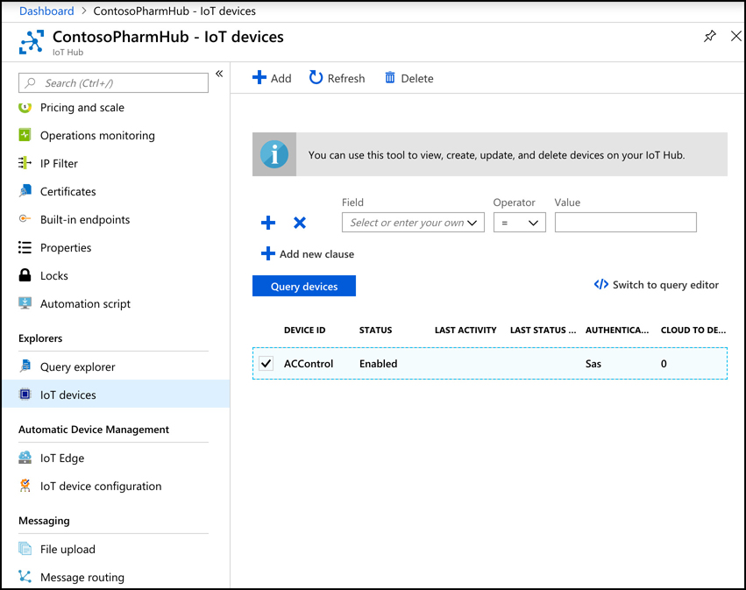
Internet of Things (IoT)
IoT devices are added to IoT Hub, and you can then manage them, monitor them, and send messages to them, either individually or to groups that you create. You can add up to 1,000,000 IoT devices to a single IoT Hub.
Azure IoT Hub

Slide 5
Internet of Things (IoT)
From IoT Hub, you can send messages to devices (called cloud-to-device, or C2D messaging) or from your device to IoT Hub (called device-to-cloud, or D2C messaging). You can also intelligently route messages to Event Hub, Azure Storage, and Service Bus based on the content in the message.
When you add a new IoT device, IoT Hub creates a connection string that uses a shared access key for authentication. This key prevents unauthorized access to your IoT Hub. Once connected, messages between your device and IoT Hub are encrypted for additional security.
In addition to messages, you can also use IoT Hub to send files to your devices. This allows you to easily update the firmware on your devices in a secure way. To update the firmware on an IoT device, you simply copy the firmware to the device. The device will detect the firmware and will reboot and flash the new firmware to the device.
Azure IoT Hub

Slide 6
Internet of Things (IoT)
From IoT Hub, you can send messages to devices (called cloud-to-device, or C2D messaging) or from your device to IoT Hub (called device-to-cloud, or D2C messaging). You can also intelligently route messages to Event Hub, Azure Storage, and Service Bus based on the content in the message.
When you add a new IoT device, IoT Hub creates a connection string that uses a shared access key for authentication. This key prevents unauthorized access to your IoT Hub. Once connected, messages between your device and IoT Hub are encrypted for additional security.
In addition to messages, you can also use IoT Hub to send files to your devices. This allows you to easily update the firmware on your devices in a secure way. To update the firmware on an IoT device, you simply copy the firmware to the device. The device will detect the firmware and will reboot and flash the new firmware to the device.
Each device twin can contain metadata that adds additional categorization for the device. This metadata is stored as tags in the JSON for the device twin, and it’s not known to the actual device. Only IoT Hub can see this metadata.
Azure IoT Hub

Slide 7
Internet of Things (IoT)
The device twin also contains the properties for the IoT device. There are two copies of every property. One is the “reported” property, and the other is the “desired” property. You can change a device property in IoT Hub by changing the “desired” property to a new value. The next time the device connects to IoT Hub, that property will be set on the device. Until that happens, the “reported” property will contain the last value the device reported to IoT Hub. Once the property is updated, the “reported” and “desired” property will be equal.
The reason IoT Hub uses this method for setting properties is that it may not always have a connection to every device. For example, if a device puts itself to sleep to save power, IoT Hub can’t write property changes to that device. By keeping a “desired” and “reported” version of every property, IoT Hub always knows if a property needs to be written to a device the next time the device connects to IoT Hub.
Azure IoT Hub

Slide 8
Internet of Things (IoT)
To help with users who want to add a large number of IoT devices to IoT Hub, Microsoft offers the IoT Hub Device Provisioning Service, or DPS. The DPS uses enrollment groups to add devices to your IoT Hub. The concept is that once the device wakes up (oftentimes for the first time if it’s a new device), it needs to know that it should connect to your IoT Hub. In order to do that, the DPS needs to uniquely identify the device, and it does that with either a certificate or via a trusted platform module chip.
Once DPS confirms the identity of the device, it can use the enrollment group details to determine which IoT Hub it should be added to. It will then provide the device with the connection information to connect to that IoT Hub. In addition to that, the enrollment group can also provide the initial configuration for the device twin. This allows you to specify properties such as a firmware version that the device needs to have in when it starts.
Azure IoT Hub

Slide 9
Internet of Things (IoT)
As your devices send messages to IoT Hub, you can route those messages to Azure Storage, Event Hub, and various other endpoints. You can choose the type of messages you want to route, and you can also write a query to filter which messages are routed.
There are two pricing tiers for IoT Hub: Basic and Standard. Each tier offers multiple editions that offer pricing based on the number of messages per day for each IoT Hub unit. When you scale an IoT Hub, you add additional units. This adds the ability to handle more messages at an increased price.
Azure IoT Hub
IoT Hub Basic tier pricing
Edition | Monthly Price per IoT Hub Unit | Messages per day per IoT Hub Unit
B1 | $10 | 400,000
B2 | $50 | 6,000,000
B3 | $500 | 300,000,000

Slide 10
Internet of Things (IoT)
IoT Hub Standard tier pricing
Edition | Monthly Price per IoT Hub Unit | Messages per day per IoT Hub Unit
Free | Free | 8,000
S1 | $25 | 400,000
S2 | $250 | 6,000,000
S3 | $2,500 | 300,000,000
Azure IoT Hub
If you use the Device Provisioning Service, there’s a charge of $0.10 for every 1,000 operations.

Slide 11
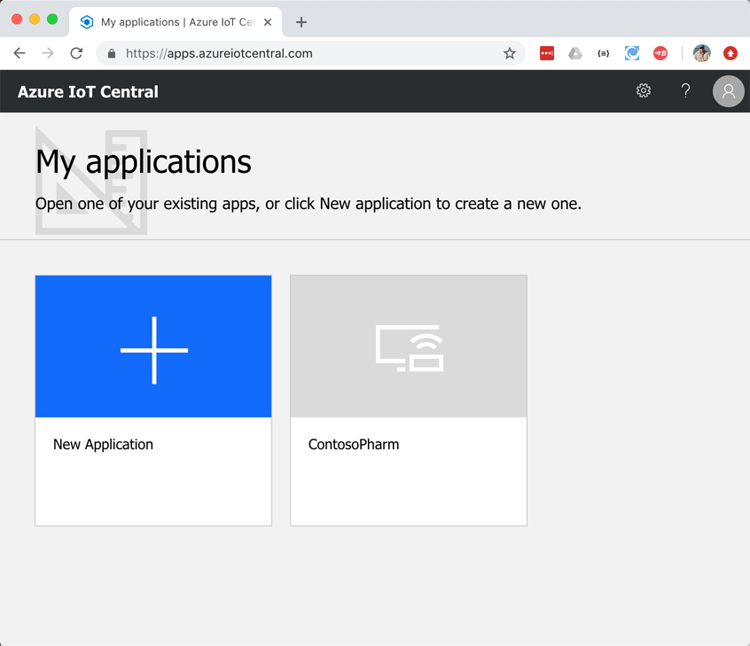
Internet of Things (IoT)
IoT Hub is a great way to manage and provision devices, and it provides a robust means of dealing with messages. You can even use Azure Stream Analytics to route messages to Power BI for a near real-time dashboard of device messages, but doing that requires a bit of complex configuration. If you’re looking for a first-class experience in monitoring IoT devices without having to do complex configuration, IoT Central is a good choice.
IoT Central is a SaaS offering for IoT devices. Unlike IoT Hub, you don’t have to create any Azure resources to use IoT Central. Instead, you browse to https://apps.azureiotcentral.com and create your app within the web browser interface.
Azure IoT Central

Slide 12
Internet of Things (IoT)
To create an IoT app, click on New Application. This opens the Create Application screen, where you can choose either the Trial plan (which does not require an Azure subscription) or Pay-As-You-Go using an Azure subscription.
If you choose a Trial plan, you have 7 days to test IoT Central with any number of devices at no charge, and you can upgrade the app to Pay-As-You-Go at any time within those 7 days.
If you choose Pay-As-You-Go, you pay based on the number of devices you have, but the first five devices are always free.
You also have the choice of choosing a template, or creating a blank template.
After you select your template, scroll down to specify the name for your app and the URL. Also, once your app has been created, you access it directly by using the URL you specify, so you may want that to be descriptive as well.
Azure IoT Central

Slide 13
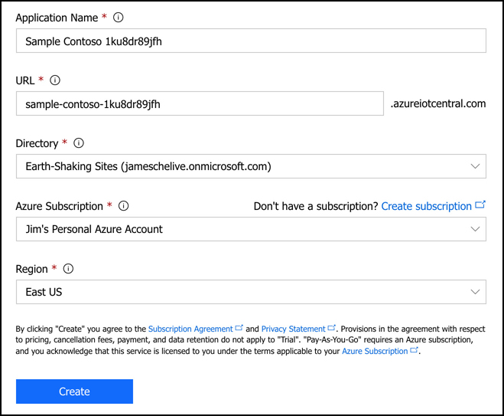
Internet of Things (IoT)
If you’re using Pay-As-You-Go, you’ll need to specify an Azure Active Directory associated with your subscription, your Azure subscription, and the region where you want to create your app.
Azure IoT Central

Slide 14
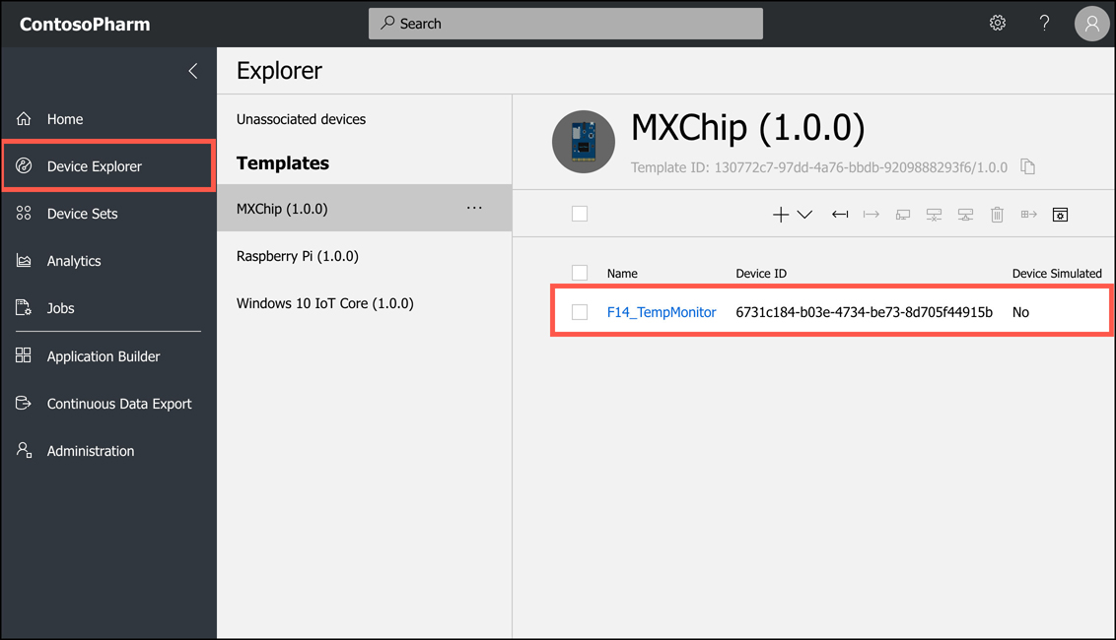
Internet of Things (IoT)
if you click on Device Explorer, you can see any devices added
Azure IoT Central

Slide 15
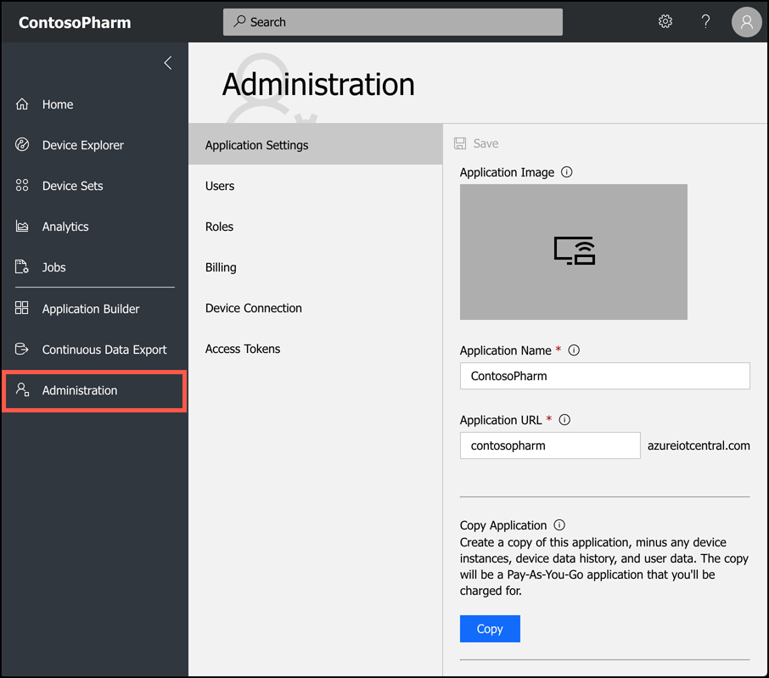
Internet of Things (IoT)
To administer your application, click on Administration on the menu on the left. You can then add and remove users, adjust user roles, change the application name or URL, add a custom image for your application, and so on. You can also copy or delete your application from this screen.
Azure IoT Central

Slide 16
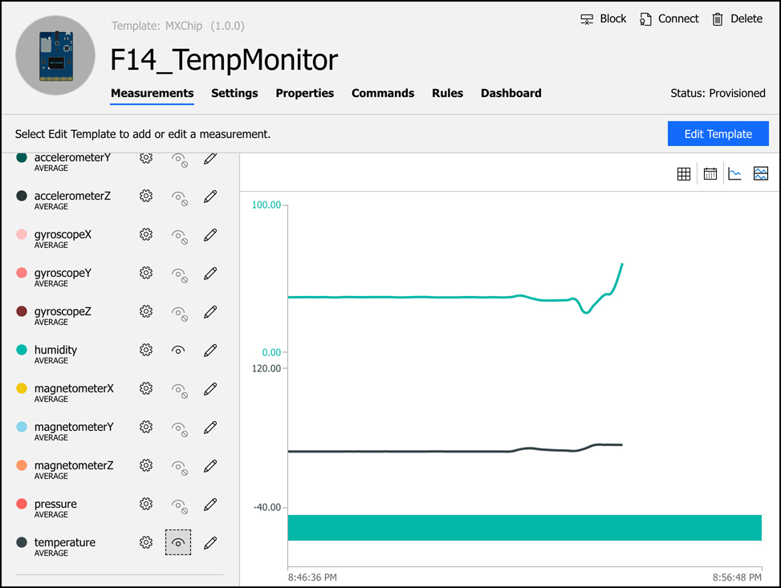
Internet of Things (IoT)
If you click on a device, you can look at information coming from the device’s sensors
Azure IoT Central

Slide 17
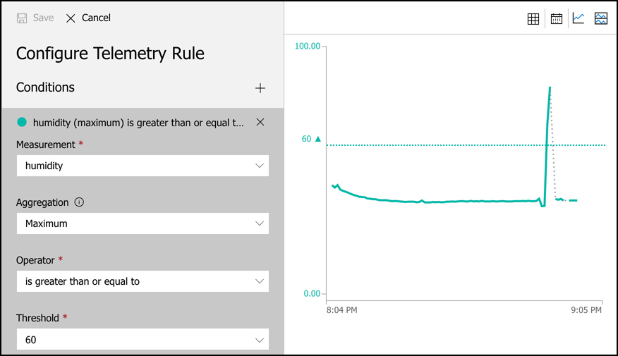
Internet of Things (IoT)
IoT Central also allows you to easily configure rules that will monitor your devices and perform an action you choose when your rule is activated. Notice that we also have a live historical view of the metric in a graph on the right so that you can make more intelligent decisions about the thresholds.
When a rule is triggered, IoT Central can send an email to someone with details of what happened. You can also choose to trigger a webhook, make a call to an Azure Function, run a workflow in an Azure Logic App, or run a workflow in Microsoft Flow.
Azure IoT Central

Slide 18
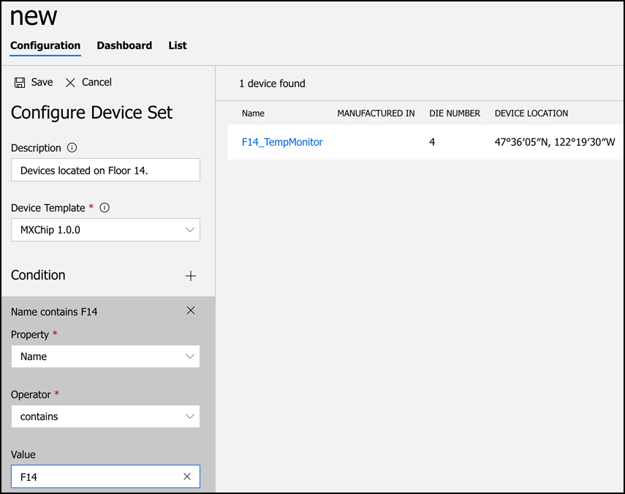
Internet of Things (IoT)
When you have a large number of devices, it’s convenient to group devices into a device set so that you can take action on many devices at a time. To create a device set, specify a condition that should be met for a device to be added to the set.
Azure IoT Central

Slide 19
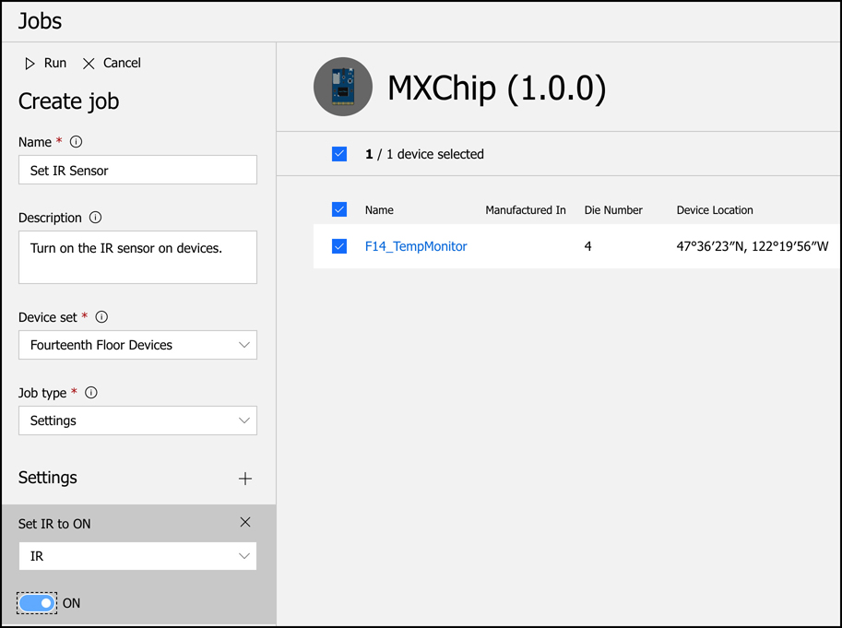
Internet of Things (IoT)
Once you’ve created a device set, you can take action on the devices in it by creating a job. Click on Jobs on the main menu of your application to configure your job. A job can modify properties, change settings, or send commands to devices.
IoT Central also allows you to perform analytics on metrics from devices in a device set.
Azure IoT Central

Slide 20
Agenda
Internet of Things (IoT)
Big Data and analytics
Artificial Intelligence
Serverless computing

Slide 21
Big Data and analytics
Businesses collect tremendous amounts of data from many different sources. As you’ve already learned, Microsoft offers an SLA on Azure services that are in the area of 99.9%+ for availability. Microsoft doesn’t put that number out there and then just cross their fingers that nothing goes wrong. They maintain enormous amounts of data on how the Azure infrastructure is operating, and they use that data to predict problems and react to them before they impact customers.
Big data means more data than you can analyze through conventional means within the desired time-frame. By placing big data in a data warehouse, you can then use massive amounts of computing power to analyze multiple pieces of data in parallel, and you can perform analysis on the data much more quickly than you otherwise could.

Slide 22
Big Data and analytics
Azure SQL Data Warehouse is designed for storing big data that’s in the form of relational data. Data stored in SQL Data Warehouse is in a form quite similar to tables in a SQL Server database, and in fact, when you analyze data in SQL Data Warehouse, you run complex SQL queries against the data.
Secure authentication using both SQL Server Authentication in the connection string, which is username and password authentication, and Azure Active Directory. Once a user is authenticated, you can only perform actions that you’ve been authorized to perform, and that authorization is controlled via database permissions.
While your data is in SQL Data Warehouse, it’s encrypted using Transparent Data Encryption (TDE) AES-256 encryption. Data is encrypted using a database encryption key, and this key is protected by a server certificate that’s unique to each SQL Database server. These certificates are rotated by Microsoft at least every 90 days, so you can be assured that your data is safe.
Azure SQL Data Warehouse

Slide 23
Big Data and analytics
SQL Data Warehouse uses several methods to control costs.
There are two performance tiers available in SQL Data Warehouse, and both of them support scaling up or down and pausing resources so you don’t pay for them.
The Gen1 performance tier measures compute resources in Data Warehouse Units, or DWUs. When you scale Gen1 data warehouses for more power, you add DWUs.
The Gen2 tier uses compute Data Warehouse Units, or cDWUs. The difference is that Gen2 uses a local disk-based cache in order to improve performance. As long as you don’t scale or pause the data warehouse, the cache will substantially improve performance. If you do scale or pause, when the data warehouse is restarted, the cache will have to be refreshed, and you won’t experience the same performance improvement until that refresh is complete.
Azure SQL Data Warehouse

Slide 24
Big Data and analytics
To use SQL Data Warehouse, you create an instance of it in Azure and then you load data into it using either queries against the database or by using tools like ADF Copy, SQL Server Integration Services, or the command line. You can then run complex queries against your data. Because of the power of SQL Data Warehouse, queries that would otherwise take several minutes to run can run in seconds, and a query that might take days to complete can finish in hours. Finally, you can use Microsoft’s Power BI to gain important insight into your data in an easy-to-use web browser-based environment.
Azure SQL Data Warehouse

Slide 25
Big Data and analytics
Like SQL Data Warehouse, Azure Data Lake Storage is designed for storing large amounts of data that you’d like to analyze, but Data Lake Storage is designed for a wide array of data instead of relational data. In a data lake, data is stored in containers. Each container typically contains related data.
The two common modes of accessing data are object-based (such as Azure Blob Storage) and file-based. In an object-based mode, there isn’t a hierarchy of objects. You simply store the object in a flat model. Traditional data lakes use the object-based access mode, but using this mode isn’t always efficient because it requires that you individually interact with each object.
With the introduction of Data Lake Storage Gen2, Microsoft introduced the concept of a hierarchical namespace to storage. This organizes the objects into a system of directories much like the structure of the files on your computer, and it allows for the use of both object-based and file-based models in the same data lake. Microsoft calls this capability multi-modal storage, and Data Lake Storage Gen2 is the first cloud-based solution to offer this capability.
Azure Data Lake Storage

Slide 26
Big Data and analytics
Data Lake Storage is ideal for performing analysis against large amounts of data that aren't stored in a relational way.
Like Azure Blob Storage, Data Lake Storage is available in Hot, Cool, and Archive tiers. The Hot tier has the highest storage costs, but the lowest access costs. The Archive tier has the lowest storage costs, but it has the highest access costs.
If you use the file-based storage in Data Lake Storage Gen2, there are some additional costs for the metadata necessary to implement the file-based hierarchy. There are also some additional costs associated with operations that require recursive calls against the hierarchy. Data Lake Storage supports several open source data analytics platforms, including HDInsight, Hadoop, Cloudera, Azure Databricks, and Hortonworks.
Once you have data available in SQL Data Warehouse or Data Lake Storage, you can use one of Azure’s analytic services to analyze the data, including Azure HDInsight and Azure Databricks.
Azure Data Lake Storage

Slide 27
Big Data and analytics
HDInsight makes it possible to easily create and manage clusters of computers on a common framework designed to perform distributed processing of big data. HDInsight is essentially Microsoft’s managed service that provides a cloud-based implementation of a popular data analytics platform called Hadoop, but it also supports many other cluster types.
Cluster Type | Description
Hadoop | Large-scale data processing that can incorporate additional Hadoop components such as Hive (for SQL-like queries), Pig (for using scripting languages), and Oozie (a workflow scheduling system.)
HBase | Extremely fast and scalable NoSQL database.
Storm | Fast and reliable processing of unbounded streams of data in real-time.
Spark | Extremely fast analytics using in-memory cache across multiple operations in parallel.
Interactive Query | In-memory analytics using Hive and LLAP (processes that execute fragments of Hive queries).
R Server | Enterprise-level analytics using R, a language that’s specialized for big data analytics.
Kafka | Extremely fast processing of huge numbers of synchronous data streams, often from IoT devices.
Azure HDInsight

Slide 28
Big Data and analytics
Building your own cluster is time-consuming and often difficult unless you have previous experience. With HDInsight, Microsoft does all of the heavy lifting on their own infrastructure. You benefit from a secure environment, and one that is easily scalable to handle huge data processing tasks.
An HDInsight cluster performs analytics by breaking up large data blocks into segments that are then handed off to nodes within the cluster. The nodes then perform analytics on the data and reduce it down to a result set. All of this work happens in parallel so that operations are completed dramatically faster than they would be otherwise. By adding additional nodes to a cluster, you can increase the power of your analytics and process more data even faster.
Azure HDInsight

Slide 29
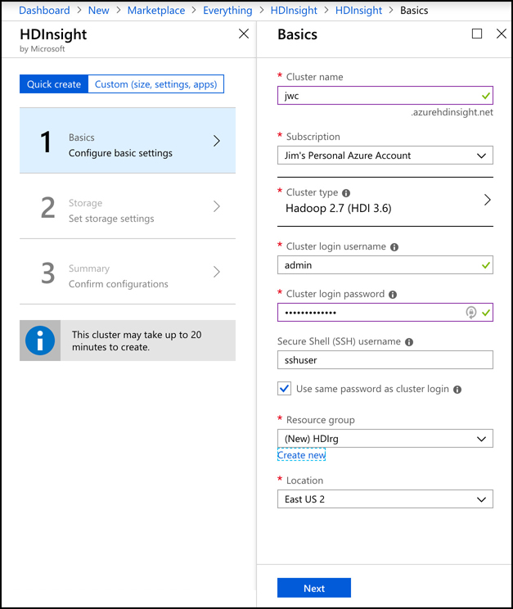
Big Data and analytics
When you create an HDInsight cluster, you specify the type of cluster you want to create and give your cluster a name. You will also specify a username and password for accessing the cluster and an SSH user for secure remote access.
Azure HDInsight

Slide 30
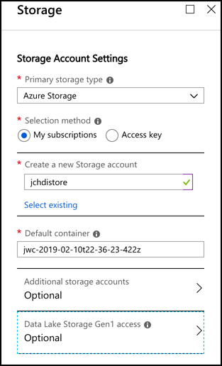
Big Data and analytics
To use Data Lake Storage Gen2, you must create the storage account first and complete some additional configuration as outlined at: https://azure.microsoft.com/blog/azure-hdinsight-integration-with-data-lake-storage-gen-2-preview-acl-and-security-update/.
Azure HDInsight

Slide 31
Big Data and analytics
Once you start the creation of your Hadoop cluster, it may take up to 20 minutes to complete, depending on your configuration. Once your cluster is ready, you can start the analysis of data by writing queries against it. Even if your queries are analyzing millions of rows, HD Insight can handle it, and if you need more processing power, you can add additional nodes as needed.
HD Insight clusters are billed on a per hour basis, and you pay more per hour based on how powerful the machines are in your cluster.
Azure HDInsight

Slide 32
Agenda
Internet of Things (IoT)
Big Data and analytics
Artificial Intelligence
Serverless computing

Slide 33
Artificial Intelligence
The AI of today is called Artificial Narrow Intelligence (or sometimes weak AI), and it refers to an AI that is capable of performing one specific task much more efficiently than a human can perform that same task. All of the AI that we’ve developed so far is weak AI. On the other end of the AI spectrum is Artificial General Intelligence, or strong AI. This is the type of AI you see depicted in movies and science fiction books, and we don’t currently have this kind of capability.
In order to develop AI capabilities, computer engineers set out to give computers the ability to “learn” in the same way that the human brain learns. Our brain is made up of neurons and synapsis. Each neuron communicates with all of the other neurons in the brain, and together, they form what’s known as a neural network. While each neuron on its own can’t do much, the entire network is capable of extraordinary things.

Slide 34
Artificial Intelligence
AI works by creating a digital neural network. Each part of that neural network can communicate and share information with every other part of the network. Just like our brains, a computer neural network takes input, processes it, and provides output. AI can use many methods for processing the input, and each method is a subset of AI. The two most common are natural language understanding and machine learning.
Natural language understanding is AI that is designed to understand human speech. If we were to try and program a computer to understand the spoken word by traditional computing means, it would take an army of programmers decades to come anywhere close to usable recognition. Not only would they have to account for accents and vocabulary differences that occur in different geographic regions, but they’d have to account for the fact that individuals often pronounce words differently even in the same regions. People also have difference speech cadences, and that causes some words to run together. The computer has to know how to distinguish individual words when that might not be easy to do. In addition to all of this complexity, the computer has to account for the fact that language is an ever-changing thing.
Machine learning (ML) is similar in that it uses a neural network to accomplish a task, but the task is different than understanding speech. In fact, machine learning can be used in many applications. One of the common uses of machine learning is image recognition. As it turns out, AI neural networks are particularly good at recognizing patterns in images, and just like audio, we have an enormous amount of data to work with.

Slide 35
Artificial Intelligence
Microsoft offers many technologies in Azure to help you with your AI and ML needs. You can even get started without doing any of your own AI and ML work by using some of the provided services that Microsoft itself uses. These services are part of Azure Cognitive Services, and they include:
Computer Vision Analyze images and recognize faces, text, and handwriting.
Microsoft Speech Recognize, transcribe, and translate speech.
Language Understanding Intelligent Service (LUIS) Natural language service that uses ML to understand speech and take action on it.
Azure Search and Bing Search Search for specific data in order to build complex data sets.

Slide 36
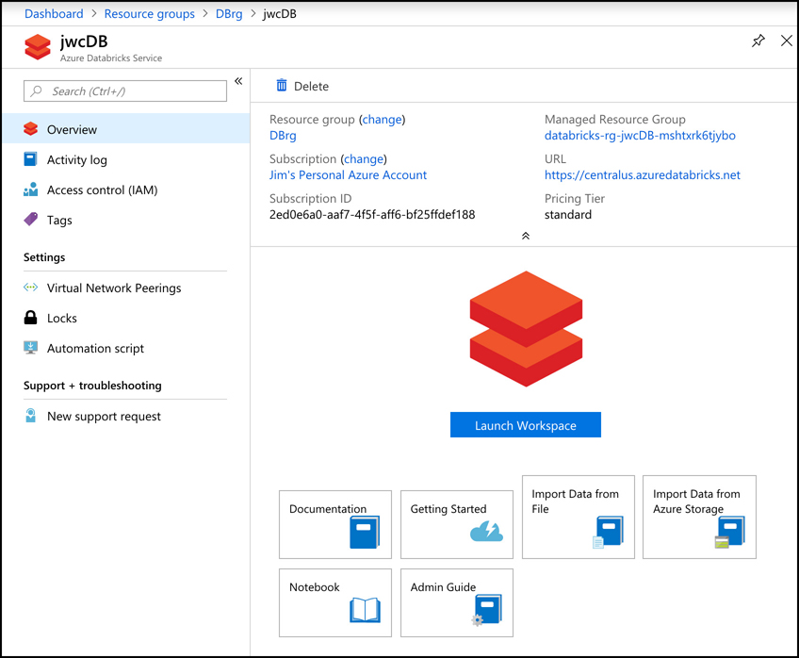
Artificial Intelligence
We’ve looked at some of the Azure services for storing big data such as SQL Data Warehouse and Azure Data Lake Storage. Data that gets stored in these services is typically raw data that is often unstructured and difficult to consume in order to build a ML model. We also may need data for our ML model that comes from multiple sources, some of which may even be outside of Azure. Azure Databricks is an ideal solution for accumulating data and for forming the data (called data modeling) so that it’s optimal for ML models.
Azure Databricks

Slide 37
Artificial Intelligence
When clicking on Launch Workspace, you’re taken to the Databricks workspace. Azure will automatically log you in when you do this using your Azure account. My Databricks instance is completely empty at this point. Along the left side of the page are links to access all of the Databricks entities such as workspaces, tables, and jobs. There’s also a Common Tasks section, which allows you to access these entities, as well as to create new notebooks, which are detailed soon.
Azure Databricks

Slide 38
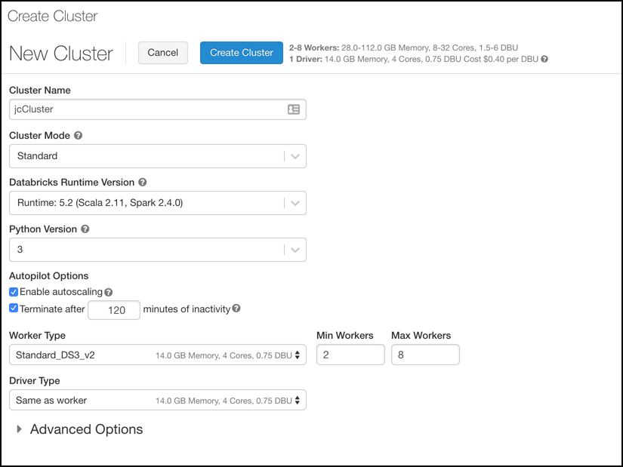
Artificial Intelligence
Let’s now create a cluster. Databricks does all of its work using clusters, which are the compute resources. To create a cluster, you can click on New Cluster under Common Tasks. You’ll now see the Create Cluster screen, where the new cluster has been named “jcCluster,” and all other options are the default
Azure Databricks

Slide 39
Artificial Intelligence
Next, we’ll create a notebook. Notebooks are a powerful way to present and interact with data that is related. Each notebook contains not only data, but also visualizations and documentation of that data to help us understand the data. Once your data is in your notebook, you can run commands against ML frameworks in order to build your ML model right inside of your notebook.
Clicking the Azure Databricks button in the menu on the left allows you to then click on New Notebook to create a notebook.
After you create a new notebook, you’ll see an empty notebook with one cell. Inside of that cell, you can enter any data that you wish.
If you click outside of this cell, the markdown code will be rendered in HTML format. In order to add some data to this notebook, you need to create a new cell by pressing “B” on your keyboard or by hovering over the existing cell and clicking the “+” button to add a new cell.
After pressing “B” on your keyboard, a new cell is inserted at the end of your notebook. You can enter some SQL code in this cell in order to populate a table with some data
Azure Databricks

Slide 40
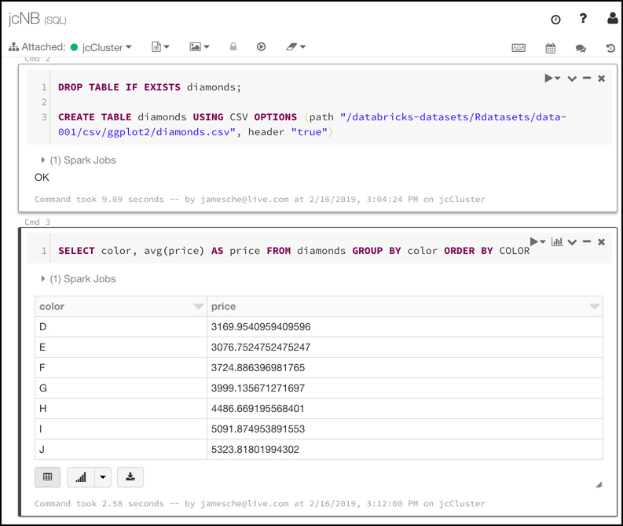
Artificial Intelligence
You can run a query against the data that was added using the command by writing a SQL query in a new cell
Azure Databricks

Slide 41
Artificial Intelligence
When you run commands in a cell, Databricks creates a job that runs on the compute resources you allocated to your cluster. Databricks uses a serverless model of computing. That means that when you’re not running any jobs, you don’t have any VMs or compute resources assigned to you. When you run a job, Azure will allocate VMs to your cluster temporarily in order to process that job. Once the job is complete, it releases those resources.
This example is quite simple, but how does all of this relate to ML? Azure Databricks includes the Databricks Runtime for Machine Learning (Databricks Runtime ML) so that you can use data in Databricks for training ML algorithms. The Databricks Runtime ML includes several popular libraries for ML, including: Keras, PyTorch, TensorFlow, and XGBoost. It also makes it possible to use Horovod for distributed deep learning algorithms. You can use these components without using Databricks Runtime ML. They’re open source and freely available, but the Databricks Runtime ML saves you from the hassle of learning how to install and configure them.
Azure Databricks

Slide 42
Artificial Intelligence
Once you’ve built your ML model in Databricks, you can export it for use in an external ML system. This process is referred to as productionalizing the ML pipeline, and Databricks allows you to productionalize using two different methods: MLeap and Databricks ML Model Export.
MLeap is a system that can execute an ML model and make predictions based on that model. Databricks allows you to export your model into what’s called an MLeap bundle. You can then use that bundle in MLeap to run your model against new data.
Databricks ML Model Export is designed to export your ML models and pipeline so that they can be used in other ML platforms. It’s specifically designed to export Apache Spark-based ML models and pipelines.
Azure Databricks

Slide 43
Artificial Intelligence
The Azure Machine Learning Service provides a cloud-based solution for building ML models. The Machine Learning Service uses a programming language called Python, so you’ll need to be familiar with Python to use the service.
The main purpose of the Azure Machine Learning Service is to use cloud-based resources to run the complex computations necessary to build ML models. Unlike Databricks where everything is in the cloud, with Machine Learning Service, you can build your data sets on-premises and then upload your data to the cloud to do ML modeling.
Like Databricks, Machine Learning Service uses notebooks. You can use Jupyter Notebooks on-premises, but you can also use Azure Notebooks, a cloud-based Jupyter Notebook offering from Microsoft. Whether you use a local notebook or Azure Notebooks, you’ll typically start things off by training your model locally in order to save on compute costs. Once you’re ready to train your model in Machine Learning Services, you can move the data to the cloud, create a cloud-based script for your model, and start training your model, all within your notebook.
Azure Machine Learning Service

Slide 44
Artificial Intelligence
When you submit your model to your Machine Learning Service cluster for training, it will prepare the model and then queue it for training in the cluster. Like Databricks, the Machine Learning Service is a serverless service, meaning you only use compute resources when your using the cluster. When you submit a job, it’s queued until compute resources are available, usually taking only a few seconds. Once your job completes, those resources are released.
Azure Machine Learning Service

Slide 45
Artificial Intelligence
When you train models in Machine Learning Services, a Docker container is created, and your model actually runs inside of that container. A Docker container is a zipped copy of everything that’s necessary to run your model. That zipped copy is called a Docker image, and it can be run on any computer that is running the Docker runtime, including the VM that makes up your Machine Learning Services cluster.
When you want to export your model so that you can use it in a production workload, you can export it as a Docker image. By using Docker images, Machine Learning Services is able to make your model portable so that it can run just about anywhere. In addition to that, you can use powerful container clustering services like Azure Kubernetes Service to run your models at large scale.
Azure Machine Learning Service

Slide 46
Artificial Intelligence
Machine Learning Services can also export your model as an FPGA image. FPGA stands for field-programmable gate array, and it’s similar to a microprocessor except that it can be programmed by a user after manufacturing. FPGAs are extremely fast because they can be programmed explicitly for the task at hand. The only thing faster for AI processing is the application-specific integrated circuit, or ASIC, but an ASIC must be manufactured for its end purpose. It cannot be reprogrammed later.
Azure Machine Learning Service

Slide 47
Artificial Intelligence
There’s a way to deal with ML concepts in a visual way. Azure Machine Learning Studio allows people who aren’t data scientists to delve into ML and gain a better understanding of the concepts we’ve discussed up to this point.
Machine Learning Studio is SaaS for ML. It provides an easy-to-use drag and drop interface for creating, testing, and deploying ML models. Instead of having to write your own models, Machine Learning Studio includes a large collection of pre-written models that you can apply to data. The best way to get a handle on Machine Learning Studio is a hands-on approach, so let’s use Machine Learning Studio to build an ML model and test it.
Azure Machine Learning Studio

Slide 48
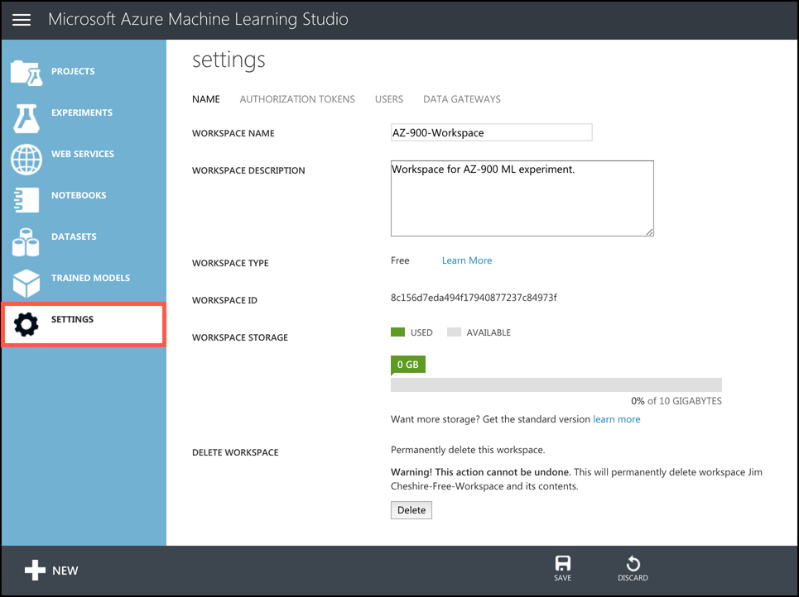
Artificial Intelligence
To launch Machine Learning Studio, open a web browser and browse to https://studio.azureml.net. Click Sign-In in the upper right corner and sign in with your Azure subscription username and password.
Once Machine Learning Studio opens, you’ll be taken to your default workspace. A workspace is a logical container for your experiments, datasets, models, and so on.
Azure Machine Learning Studio

Slide 49
Artificial Intelligence
There are two tiers in Machine Learning Studio: Free and Standard. The Free tier is for experimentation while the Standard tier is what you’d want to use if you are using your ML model in a production scenario. There are additional capabilities in the Standard tier, and you have to pay for workspaces that use the Standard tier.
When you create a workspace by browsing directly to Machine Learning Studio, it will always be in the Free tier. If you want to create a workspace in the Standard tier, you will need to use the Azure portal to create a Machine Learning Studio Workspace. You can then choose your tier
Azure Machine Learning Studio

Slide 50
Artificial Intelligence
Step 1: Create an Experiment
To create an experiment in Machine Learning Studio, click on Experiments on the menu on the left, and then click the New button at the bottom of the screen.
you’ll see a collection of templates that Microsoft provides for experiments. These are all pre-built ML experiments, and you can learn a lot by choosing one of them to see how they work, but for our purposes, we’re going to start with a blank experiment. You then click on Blank Experiment.
You’ll see a list of all the items you can add to your experiment. You’ll see a list of sample data, but if you scroll down, you’ll see all kinds of items you can use to build a model.
The main part of the screen is where you’ll build your model, and you’ll do that by dragging items from the list on the left and dropping them onto the main screen. You’ll then connect items together to build your model.
Azure Machine Learning Studio

Slide 51
Artificial Intelligence
Step 2: Add Data
Step 3: Train the Model
Step 4: Score the Model
Step 5: Train and Score the Model
Azure Machine Learning Studio

Slide 52
Agenda
Internet of Things (IoT)
Big Data and analytics
Artificial Intelligence
Serverless computing

Slide 53
Serverless computing
You can create VMs in the cloud and pay for them only when they’re running. Sometimes you just need to “borrow” a computer in order to run a computation or perform a quick task. In those situations, a serverless environment is ideal. In a serverless situation, you pay only when your code is running on a VM. When your code’s not running, you don’t pay anything.
It’s important to understand that “serverless” doesn’t mean that no VMs are involved. It simply means that the VM that’s running your code isn’t explicitly allocated to you. Your code is moved to the VM, it’s executed, and then it’s moved off.

Slide 54
Serverless computing
Azure Functions is the compute component of Azure’s serverless offerings. That means that you can use Functions to write code without having to worry about deploying that code or creating VMs to run your code. Apps that use Azure Functions are often referred to as Function Apps.
Functions can be created in many different ways. You can create a Function App using:
Microsoft Visual Studio
Microsoft Visual Studio Code
Maven for Java Function Apps
Python command line for Python Function Apps
Azure command line interface (CLI) on Windows or Linux
The Azure portal
Azure Functions

Slide 55
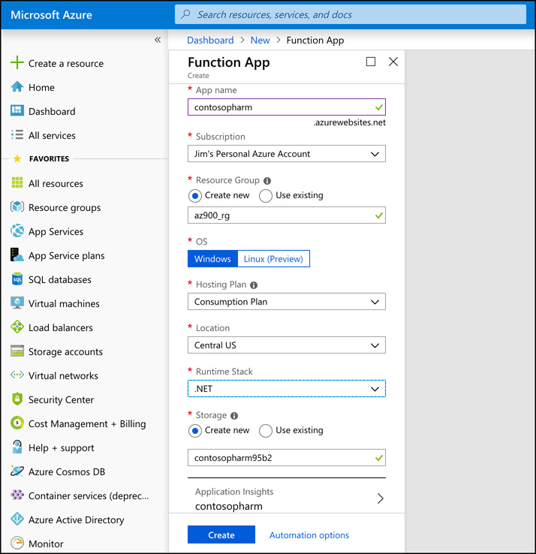
Serverless computing
we’re creating a Function App in the Azure portal, and selected .NET as the Function App runtime so that you can use the C# language to write functions.
Azure Functions

Slide 56
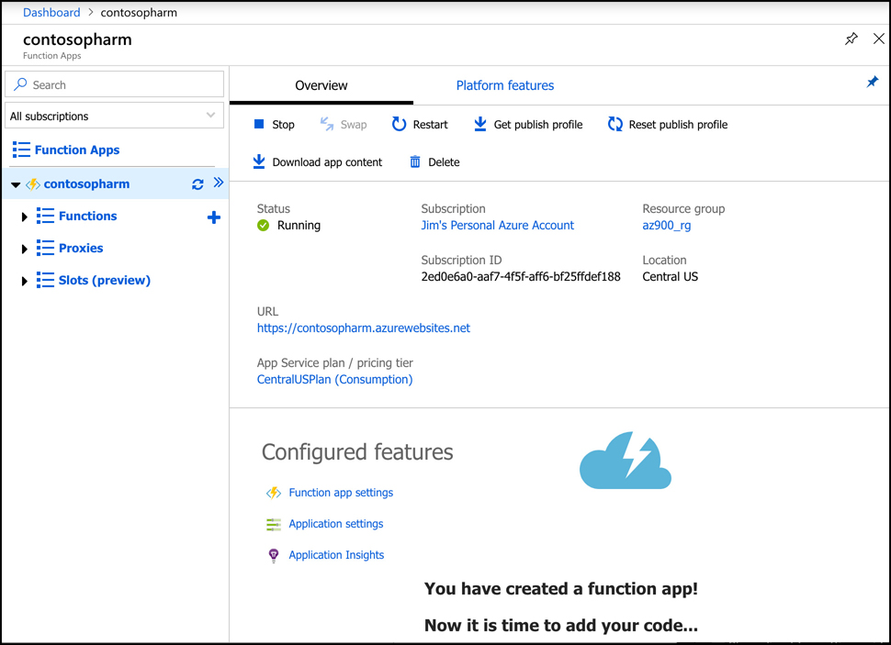
Serverless computing
Once your Function App is ready, you can open it in the portal to begin creating functions.
From here, you can create a new function, a new proxy, or a new slot. A function is code that runs when something triggers it. A proxy allows you to configure multiple endpoints for your Function App, but expose all of them via a single URL. Slots allow you to create a copy of your Function App that isn’t public-facing. You can write code and test this copy, and when you are satisfied that it’s ready for production, you can swap it over to production with the click of a button. This feature in App Service is called Deployment Slots
Azure Functions

Slide 57
Serverless computing
You can configure a daily quota for your Function App. Once you reach the quota, Azure will stop the Function App until the next day. You can also change the Function App runtime version. This is the runtime version of Azure Functions, and while it’s generally advised to use the latest version, if your functions were written in an earlier version, you won’t be able to upgrade them by simply changing the version here.
You can also change your Function App to read-only mode to prevent any changes to it. This is helpful if you have multiple developers writing code for your app and you don’t want someone changing something without your knowledge.
Finally, you can view, renew, revoke, and add new host keys. A host key is used to control access to your functions. When you create a function, you can specify whether anyone can use it or whether a key is required. Although a key can help protect your functions, they’re not designed to offer complete security of Function Apps. If you want to protect your Function App from unauthorized use, you should use authentication features available in App Service to require authentication. You can also use Microsoft API Management to add security requirements to your Function App
Azure Functions

Slide 58
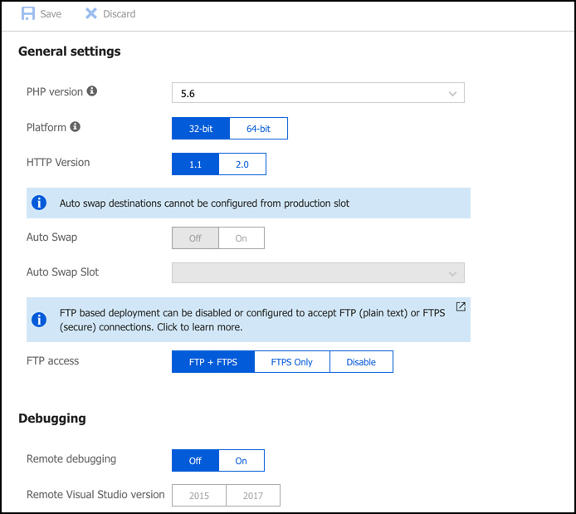
Serverless computing
If you click on Application Settings, you can configure the settings for the Function App. These are settings specific to App Service. Some of these settings: whether the app runs in 32-bit or 64-bit, the HTTP version, how you can access your files using FTP, and more. You can also configure database connection strings from this page.
Azure Functions

Slide 59
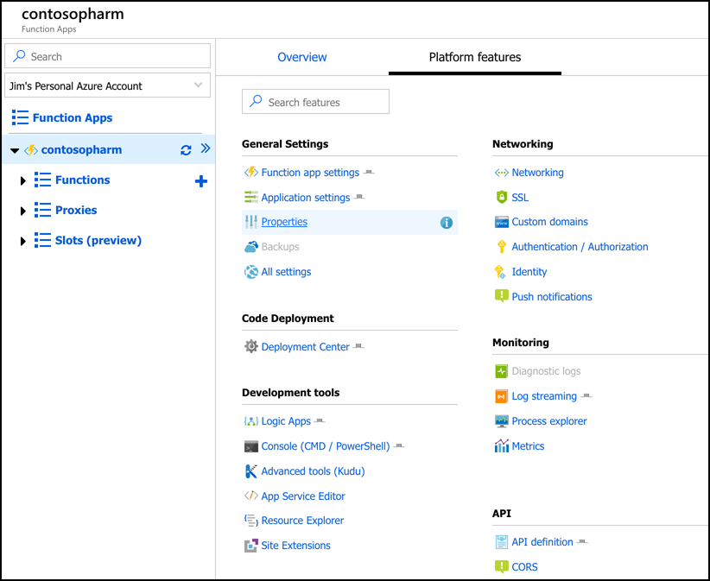
Serverless computing
if you click on the Platform Features tab, you can see all of the features available to you in the App Service platform. From here, you can configure things such as SSL certificates, custom domain names for your Function App, turn-key authentication, and more.
Azure Functions

Slide 60
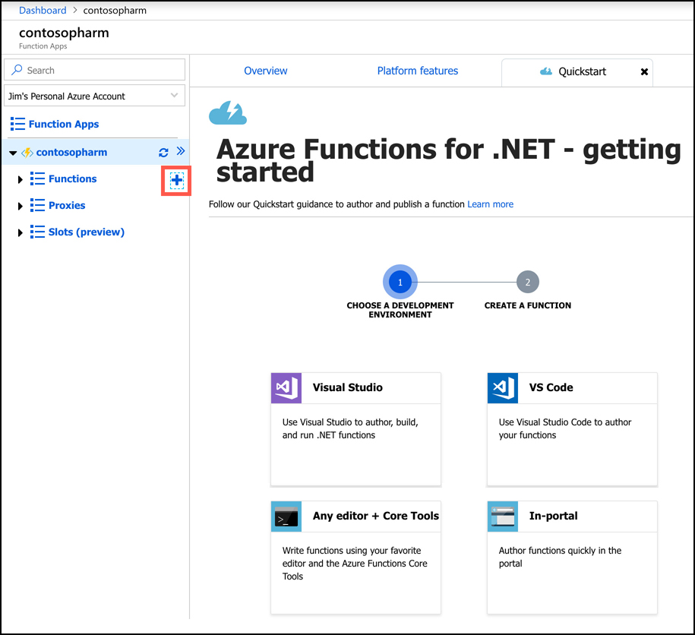
Serverless computing
To create a new function, click on the + sign as shown. You can then choose your development environment. You can choose Visual Studio, Visual Studio Code, a development environment right inside the Azure portal, or you can use a code editor of your choice alongside the Azure Functions Core Tools.
Azure Functions

Slide 61
Serverless computing
If you choose any option other than In-Portal, you’ll need to specify how you want to deploy your function to App Service. Your options depend on which development environment you choose, but typically it will involve either using features of your environment to send the function directly to App Service, or you’ll need to use App Service Deployment Center. Either way, deployment is quick and easy.
Depending on which development environment you choose, you will likely have to complete some prerequisite steps in order to develop your function. You’ll see a screen telling you exactly what to do so that everything will work correctly.
Azure Functions

Slide 62
Serverless computing
Functions work using a trigger-based system. When you create your function, you choose a trigger that will kick off your function. When it’s triggered, your function code will run. You will typically want your function code to do something simple. If you need a more complex function that performs many things, you can use Function Proxies to create several functions that work together to complete a task. This kind of development is referred to as microservices, and it allows you to quickly swap out functionality by simply changing a single function.
After your function is triggered and the code runs, you can choose what happens using what’s called an output binding. The type of bindings you can use are dependent on the type of function you create.
You can configure multiple outputs for your function as well. For more complex workflows, however, Logic Apps is often a better choice, and you can integrate Logic Apps directly with Azure Functions.
Azure Functions

Slide 63
Serverless computing
Logic Apps are similar to Function Apps in that they are kicked off by a trigger, but what happens after that is completely different. Unlike Function Apps, you don’t have to write code to create some powerful workflows with Logic Apps.
A workflow simply means that a Logic App reacts to something happening and responds by performing a series of tasks such as sending an email, transferring data to a database, and so on. It can do these things in order, but it can also do two things at once.
Azure Logic Apps

Slide 64
Serverless computing
Logic Apps are similar to Function Apps in that they are kicked off by a trigger, but what happens after that is completely different. Unlike Function Apps, you don’t have to write code to create some powerful workflows with Logic Apps.
A workflow simply means that a Logic App reacts to something happening and responds by performing a series of tasks such as sending an email, transferring data to a database, and so on. It can do these things in order, but it can also do two things at once.
Azure Logic Apps

Slide 65
Serverless computing
As an example, you might have an e-commerce site and when a customer orders a product you might want to:
Update your inventory count of the product
Generate an invoice for the item
Email the invoice to the customer
Sign the customer up for your newsletter
Generate a shipping label for the item
Logic Apps allows you to create these kinds of complex workflows easily, and because Logic Apps integrates with over a hundred other services (both Azure services and third-party services), you can do just about anything in a Logic Apps workflow.
Azure Logic Apps

Slide 66
Serverless computing
There are three components in Logic Apps that make workflows possible: connectors, triggers, and actions.
A connector is a component that connects your Logic App to something. That could be another Azure service, but it could also be a third-party service, an FTP server, and so forth. Each connector will have one or more triggers and actions specific to that connector.
A trigger is a specific action that will cause your Logic App workflow to run, and an action is what your Logic App will do as an output.
Actions: You can combine multiple actions for a connector, and you can also combine multiple connectors to create complex and powerful workflows.
Azure Logic Apps

Slide 67
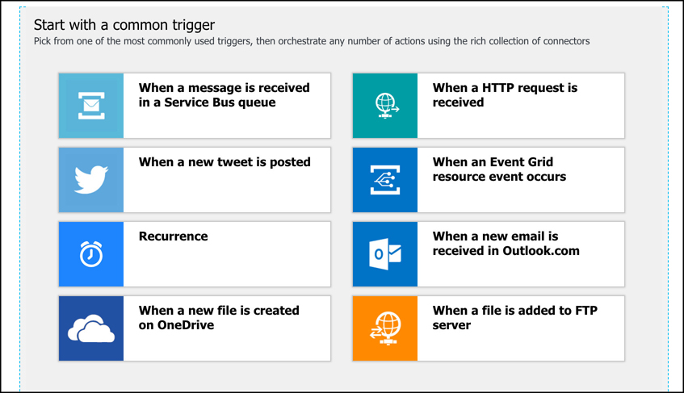
Serverless computing
You create Logic Apps in the Azure portal. Once you create it, the Logic Apps designer is shown by default. From the designer, you can choose the trigger for your Logic App
Azure Logic Apps

Slide 68
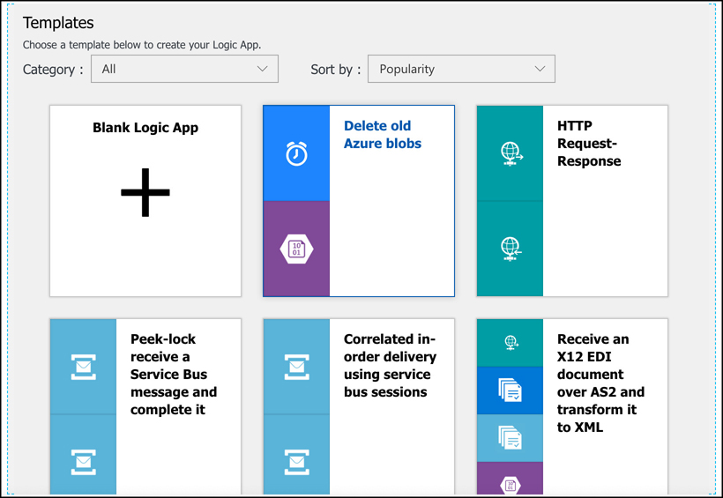
Serverless computing
If you scroll down, you’ll see a large number of templates you can use to create a Logic App. These templates will automatically configure a Logic App that contains a full workflow that you can modify for your own purposes. This is the fastest way to get started, but the included templates might not be exactly what you want, so you can also create a blank Logic App and start from scratch.
Azure Logic Apps

Slide 69
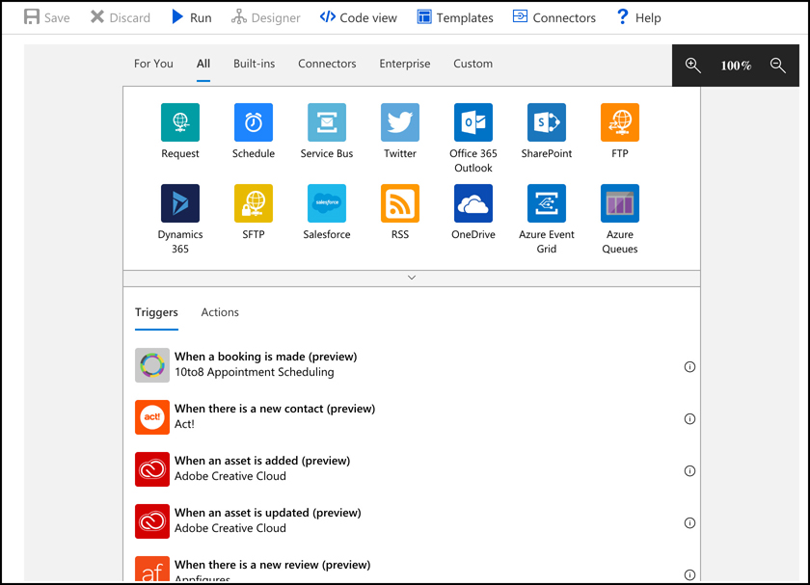
Serverless computing
After you create your blank Logic App, you can choose from several ways to start building your workflow. You can select a trigger from the list, search for a trigger or connector, or you can just select a connector from the list and see what triggers are available.
Azure Logic Apps

Slide 70
Serverless computing
In some cases, you need one Azure resource to know about a change in another Azure resource. You could use a polling method for this, similar to the Logic App checking once against OneDrive every three minutes looking for a change. It’s more efficient, however, to enable an Azure service to trigger an event when something specific happens, and configure another Azure service to listen for that event so it can react to it.
Event Grid provides that functionality.
Both Azure Functions and Azure Logic Apps are integrated with Event Grid. You can configure a function to run when an Event Grid event occurs
Azure Event Grid

Slide 71
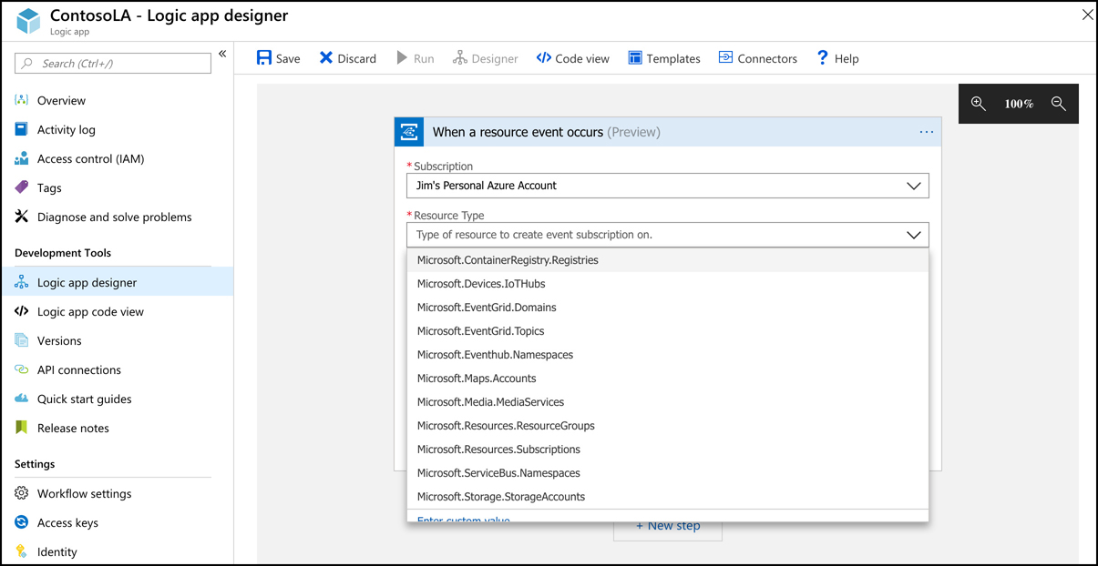
Serverless computing
You can see the list of Azure resources that you can trigger Event Grid events. Not all Azure services are represented in Event Grid, but more services are being added over time.
Once you’ve selected the resource type, configure the event you want to listen for. The events that are available may differ depending on the resource you selected.
Azure Event Grid

Slide 72
Serverless computing
When an event occurs, you can take an action against an Azure resource using the Azure Resource Manager connector in a Logic App. You can also run a script that interacts with the Azure resource to do something like tag a resource, or configure it in a way that is specific to your organization.
The primary benefit of using Event Grid in this way is the rapid development of solutions. You also benefit from Event Grid reliably triggering your events. If an Event Grid event fails to trigger for any reason, Event Grid will continue to retry triggering the event for up to 24 hours. Event Grid is also extremely cost effective. The first 100,000 operations per month are free, and after that point, you pay 60 cents for every million operations.
Azure Event Grid

